Slide 1

Buddy:Simplifying Devops Automation for Teams
Presented by Group - 8

Slide 2
Group Members
Khine Zin Nyunt 4SE - 1229
Paing Zay Khant 4SE - 1242
Htet Arkar Oo 4SE - 1084

Slide 3
Table of contents
01
02
03
04
05
06
Introduction →
Key Features →
Benefits for Teams →
Use Cases and Case Studies →
Comparison with Other DevOps Tools →
Conclusion →

Slide 4
01
Introduction →

Slide 5
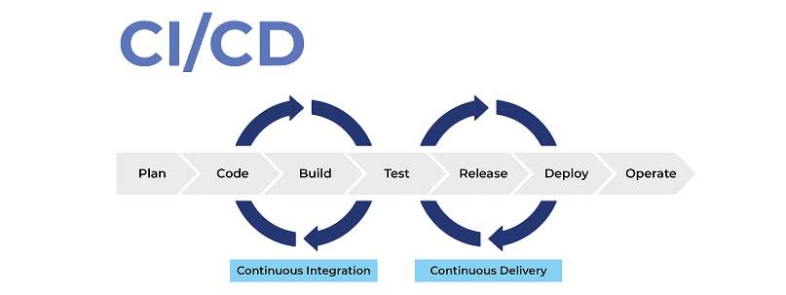

Slide 6
Benefits of CI/CD
Faster Releases | Automates building, testing, and deployment, enabling quicker and more frequent software releases.
Improved Code Quality | Automated testing ensures bugs are caught early, leading to more stable code.
Reduced Manual Work | Automation minimizes human errors and streamlines repetitive tasks like testing and deployment.
Better Collaboration | Encourages regular code merging, enhancing teamwork and reducing integration issues.
Customer Satisfaction | Faster, more reliable releases improve the user experience.
Scalability | Pipelines can handle complex architectures and grow with project needs.

Slide 7

What is Buddy?
Automation platform that streamlines DevOps workflows by simplifying CI/CD processes.
A powerful CI/CD tool that simplifies automation for building, testing, and deploying software.

Slide 8
→ Developers
→ Designers
→ QA Team
Target
Users
collaborate easily with Buddy’s intuitive visual interface

Slide 9
Importance of DevOps Automation
Handle the complexity of modern software development
Faster development cycles, improved efficiency, and reduced manual errors.
Ensures continuous integration and delivery, allowing teams to quickly adapt to changes in code.

Slide 10
02
Key Features →

Slide 11
Key Features of Buddy
1. Predefined Pipelines
Drag and drop pipelines for building, testing, and deploying code, allowing developers to easily set up pipelines for various technologies (Node.js, Python, Docker, etc.)
2. Easy Pipeline Setup
You can create pipelines with a drag-and-drop interface.
Set trigger modes for pipelines:
On Push: Runs the pipeline when code is pushed to the repository.
Manual: Trigger pipelines manually when needed.
Recurrent: Run pipelines at scheduled intervals (e.g., nightly builds)

Slide 12
Key Features of Buddy
3. Integration and Compatibility
Integrates with GitHub, Bitbucket, and GitLab, triggering pipelines automatically from repository changes
Supports Docker, Kubernetes, and cloud providers like AWS, Azure, and Google Cloud for streamlined deployment automation.
4. Environment Configuration
Supports multi-environment setups for staging, testing, and production, making code promotion between environments seamless
Automated infrastructure provisioning, reducing manual configuration and ensuring consistency across environments.

Slide 13
03
Benefits for Team →

Slide 14
Strengths
seamless teamwork with visual pipelines and intuitive interface that simplifies learning for all users
Speed
&
Efficiency
Scalability
Collaboration
accelerates workflows with fast pipeline setup and real-time feedback.
scales for all team sizes and supports microservices, enabling efficient, independent service deployments

Slide 15
04
Use Cases and Case Studies →

Slide 16
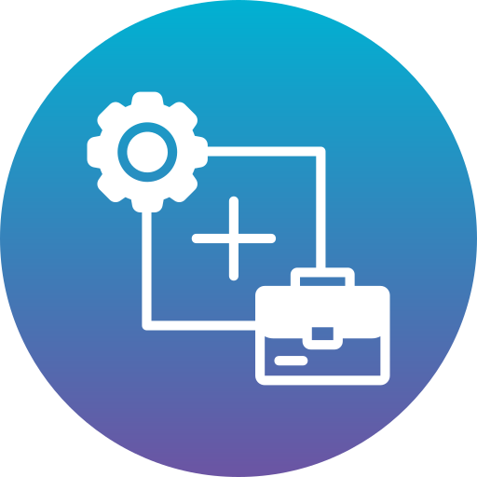
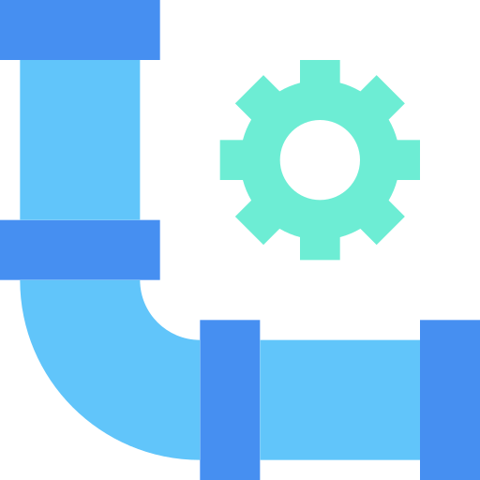
Continuous Delivery for Mobile Apps
Scenario: A team developing mobile apps needs to continuously build and deploy versions to the App Store or Google Play.
Solution with Buddy: The team can use Buddy’s pre-built actions for mobile applications to:
Build the Android or iOS app.
Run automated tests for the app.
Automatically deploy the app to Google Play or the App Store upon approval.

Slide 17

Development Workflow Automation
Example
A company reduced manual intervention, achieving faster and more reliable releases while minimizing errors and bottlenecks by adapting Buddy.
Time-Saving Benefits
Automation of repetitive tasks, such as testing and deployments, significantly improves team efficiency.

Slide 18
05
Comparison with Other DevOps Tools →

Slide 19

Buddy Vs. Jenkins
Ease of Use
User Experience
Simpler, more intuitive interface
Buddy is user-friendly for non-experts, whereas Jenkins has a steeper learning curve.
Setup Speed
Visual pipelines and predefined actions make it quicker to set up than Jenkins

Slide 20

Buddy Vs. GitLab CI/CD
Integration Features
Customization
more streamlined and preconfigured integration options
excels in making it simpler for non-experts
Faster Setup
provide quick setups for small and medium-sized projects.

Slide 21

Buddy Vs. CircleCI
Customization Options
Performance
fast pipeline execution with real-time feedback, similar to CircleCI, but with a more user-friendly interface
greater flexibility in customizing workflows and pipelines

Slide 22
06
Conclusion →

Slide 23
Why choose Buddy?
Buddy simplifies DevOps automation for all team sizes with easy setup, real-time feedback, scalable infrastructure, and enhanced productivity through automation and collaboration. Great UI,Has a free trial-experiment away, no credit card required.

Slide 24
Thanks!

